Slide 1
CMSC 471:
Machine Learning
1
Many slides courtesy Frank Ferraro

Slide 2
Why study learning?
Discover new things or structure previously unknown
– Examples: data mining, scientific discovery
Fill in skeletal or incomplete specifications in a domain
Large, complex systems can’t be completely built by hand
& require dynamic updating to incorporate new info.
Learning new characteristics expands the domain or
expertise and lessens the “brittleness” of the system
Acquire models automatically directly from data rather than by manual programming
Build agents that can adapt to users, other agents, and their environment
Understand and improve efficiency of human learning

Slide 3
What does it mean to learn?
Wesley has been taking an AI course
Geordi, the instructor, needs to determine if Wesley has
“learned” the topics covered, at the end of the course
What is a “reasonable” exam?
(Bad) Choice 1: History of pottery
Wesley’s performance is not indicative of what was learned in AI
(Bad) Choice 2: Questions answered during lectures
Open book?
A good test should test ability to answer “related” but “new”
questions on the exam
Generalization

Slide 4

Model, parameters and hyperparameters
Model: mathematical formulation of system (e.g., classifier)
Parameters: primary “knobs” of the model that are set by a learning algorithm
Hyperparameter: secondary
“knobs”
4
http://www.uiparade.com/wp-content/uploads/2012/01/ui-design-pure-css.jpg

Slide 5
Instance of data
(“datum”)

Slide 6
score(
)
Instance of data
(“datum”)

Slide 7
score ( )
scoring model
Instance of data
θ
(“datum”)
F(θ)
objective

Slide 8
score ( )
scoring model
Instance of data (“datum”)
θ
F(θ)
objective
(implicitly) dependent on the
observed data X=

Slide 9
Machine Learning Framework: Learning
instance 1
instance 2
Machine Learning Predictor
instance 3
instance 4

Slide 10
Machine Learning Framework: Learning
instance 1
instance 2
Machine Learning Predictor
instance 3
instance 4
instances are
typically examined independently
Inductive Bias

Slide 11
Machine Learning Framework: Learning
Gold/correct labels
instance 1
instance 2
Machine Learning Predictor
Evaluator
score
instance 3
instance 4
instances are
typically examined independently
Inductive Bias

Slide 12
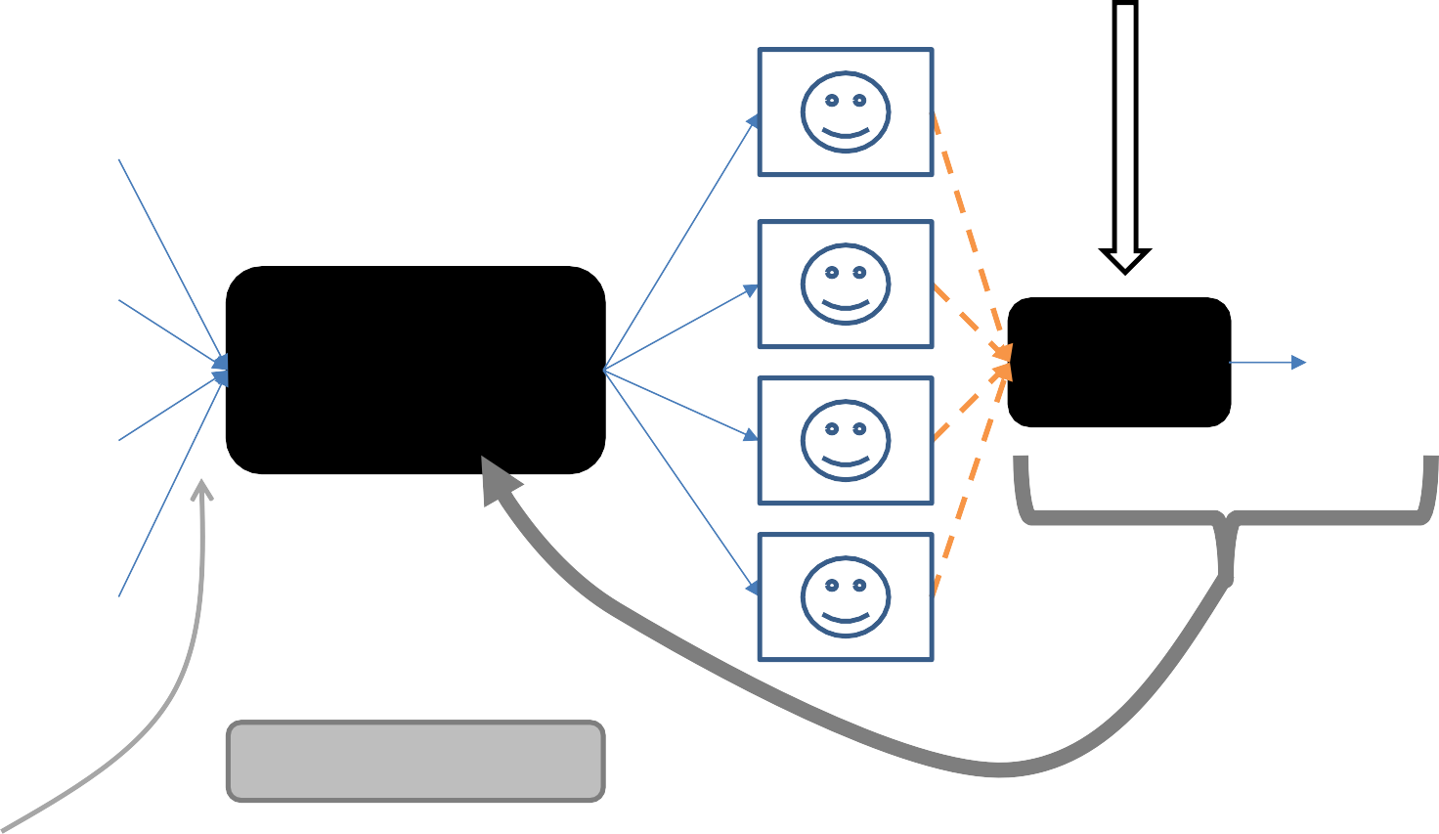
Machine Learning Framework: Learning
Gold/correct labels
instance 1
instance 2
Machine Learning Predictor
Evaluator
score
instance 3
instance 4
instances are typically examined independently
Inductive Bias
give feedback to the predictor

Slide 13

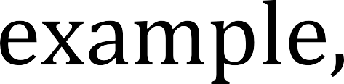
Classify with Goodness

Slide 14
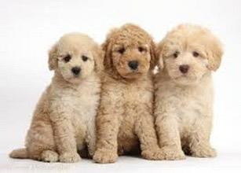

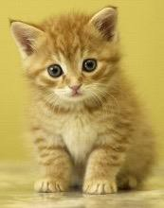

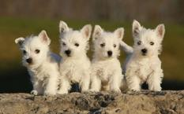


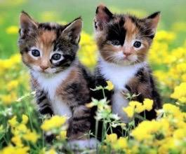


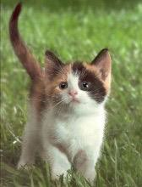

ML Framework Example
Puppy classifier
Training data
Training
Classifier
(trained
model)

Slide 15

ML Framework Example
Puppy classifier
Training data
Test data
Classifier
(trained
model)
Test
Label:
+
15

Slide 16
ML Framework Example
Puppy classifier
Training data
Train in g
Test data
Classifier
(trained
model)
Test
Label:
+
16

Slide 17
ML Framework Example
Puppy classifier
Training data, X
Training
Text- ure | Ears | Legs | Class
Fuzzy | Round | 4 | +
Slimy | Missing | 8 | -
Fuzzy | Pointy | 4 | -
Fuzzy | Round | 4 | +
Fuzzy | Pointy | 4 | +
…
Test data
x₁ = <Fuzzy, Pointy, 4>
Classifier
(trained
model)
Test
Label:
+

Slide 18
General ML Consideration: Inductive Bias
What do we know before we see the data, and how does that influence our modeling decisions?
Courtesy Hamed Pirsiavash

Slide 19






General ML Consideration: Inductive Bias
What do we know before we see the data, and how does that influence our modeling decisions?
A
B
Partition these into two groups…
C
D
Courtesy Hamed Pirsiavash

Slide 20
General ML Consideration: Inductive Bias
What do we know before we see the data, and how does that influence our modeling decisions?
A
B
Partition these into two groups
Who selected red vs. blue?
C
D
Courtesy Hamed Pirsiavash

Slide 21


General ML Consideration: Inductive Bias
What do we know before we see the data, and how does that influence our modeling decisions?
A
B
Partition these into two groups
Who selected red vs. blue?
Who selected vs. ?
C
D
Courtesy Hamed Pirsiavash

Slide 22
General ML Consideration: Inductive Bias
What do we know before we see the data, and how does that influence our modeling decisions?
A B
Partition these into two groups
Who selected red vs. blue?
Who selected vs. ?
C
D
Tip: Remember how your own biases/interpretation are influencing your approach
Courtesy Hamed Pirsiavash

Slide 23
AI & ML

Slide 24
AI and Learning Today
50s&60s: neural network learning popular
Marvin Minsky did neural networks for his dissertation
Mid 60s: replaced by paradigm of manually encoding & using symbolic knowledge
Cf. Perceptrons, Minsky & Papert book showed limitations of
perceptron model of neural networks
90s: more data & Web drove interest in statistical machine learning techniques & data mining
Now: machine learning techniques & big data play biggest driver in almost all successful AI systems
… and neural networks are the current favorite approach
seeAlso: Timeline of machine learning
24

Slide 25
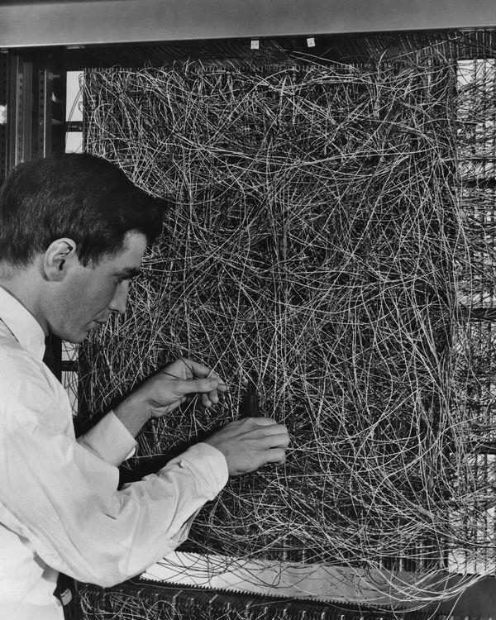
Neural Networks 1960
A man adjusting the random wiring network between the light sensors and association unit of scientist Frank Rosen- blatt's Perceptron, or MARK 1 computer, at the Cornell Aeronautical Laboratory, Buffalo, New York, circa 1960. The machine is designed to use a type of artificial neural network, known as a perceptron.

Slide 26
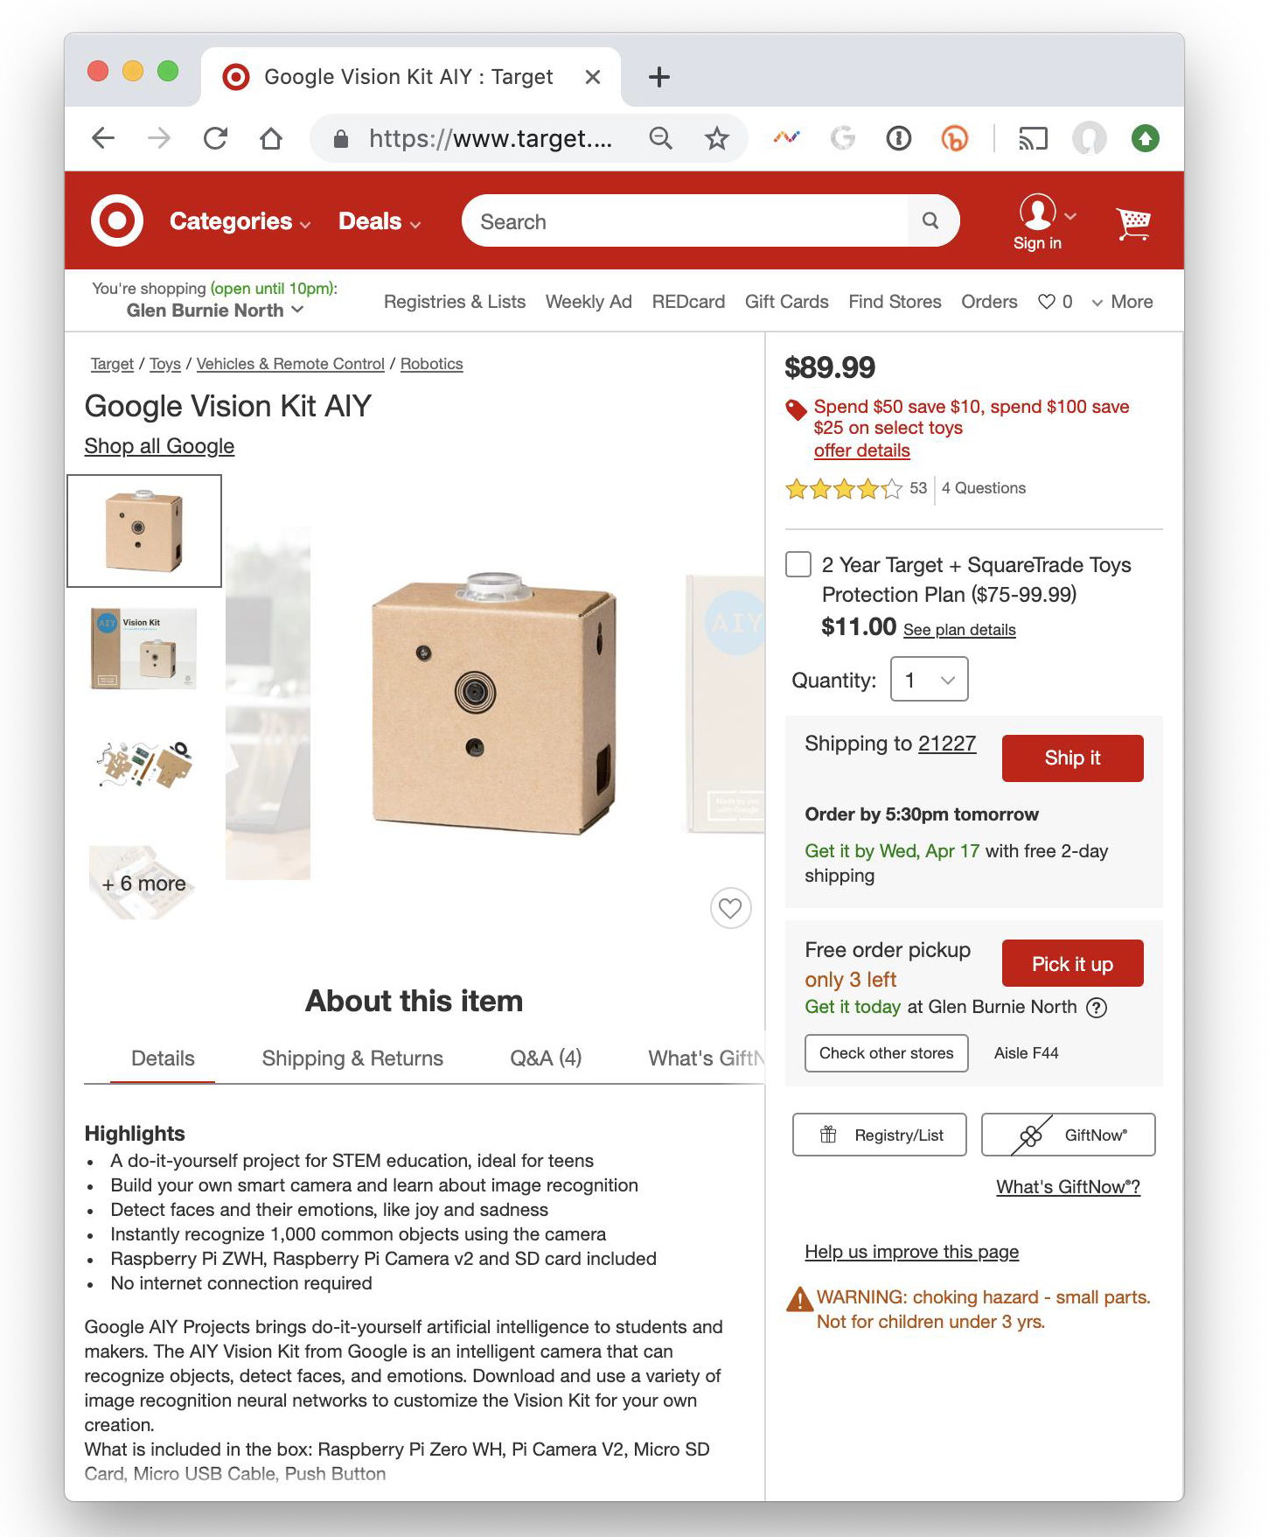
Neural Networks 2020
Google’s AIY Vision Kit ($89.99 at Target) is an intelligent camera that can recognize objects, detect faces and emotions. Download and use a variety of image recognition neural networks to customize the Vision Kit for your own creation. Included in the box: Raspberry Pi Zero WH, Pi Camera V2, Micro SD Card, Micro USB Cable, Push Button.
Currently $58.85 on Amazon

Slide 27
Machine Learning Successes
Games: chess, go, poker
Text sentiment analysis
Email spam detection
Recommender systems (e.g., Netflix, Amazon)
Machine translation
Speech understanding
SIRI, Alexa, Google
Assistant, …
Autonomous vehicles
Individual face recognition
Understanding digital images
Credit card fraud detection
Showing annoying ads

Slide 28
The Big Idea and Terminology
Given some data, learn a model of how the world works that lets you predict new data
Training Set: Data from which you learn initially
Model: What you learn; a “model” of how
inputs are associated with outputs
Test set: New data you test your model against
Corpus: A body of text data (pl.: corpora)
Representation: The computational expression of data

Slide 29
Major Machine learning paradigms (1)
Rote: 1-1 mapping from inputs to stored representation, learning by memorization, association-based storage & retrieval
Induction: Use specific examples to reach general conclusions
Clustering: Unsupervised discovery of natural groups in data

Slide 30
Major Machine learning paradigms (2)
Analogy: Find correspondence between different representations
Discovery: Unsupervised, specific goal not given
Genetic algorithms: Evolutionary search techniques, based on survival of the fittest
Reinforcement: Feedback (positive or negative reward) given at the end of a sequence of steps
Deep learning: artificial neural networks
with representation learning for ML tasks

Slide 31
CORE TERMINOLOGY

Slide 32
Three Axes for Thinking About Your ML Problem
Classification
Regression Clustering
Fully-supervised
Semi-supervised Un-supervised
Probabilistic
Neural
Generative
Memory-
based
Conditional
Exemplar
…
Spectral
the task: what kind of problem are you solving?
the data: amount of human input/number of labeled examples
the approach: how any data are being
used
32

Slide 33
Types of learning problems
Supervised: learn from training examples
Regression:
Classification: Decision Trees, SVM
Unsupervised: learn w/o training examples
Clustering
Dimensionality reduction
Word embeddings
Reinforcement learning: improve performance using feedback from actions taken
Lots more we won’t cover
Hidden Markov models, Learning to rank, Semi-supervised
learning, Active learning …
33

Slide 34
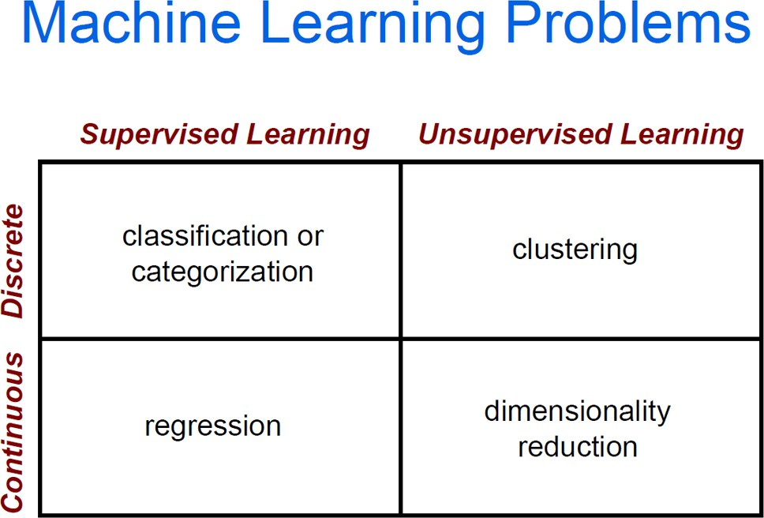

Slide 35
Supervised learning
Given training examples of inputs & corres- ponding outputs, produce “correct” outputs for new inputs
Two important scenarios:
– Classification: outputs typically labels (goodRisk, badRisk); learn decision boundary to separate classes
– Regression: aka curve fitting or function approxima- tion; Learn a continuous input-output mapping from examples, e.g., for a zip code, predict house sale price given its square footage

Slide 36
Unsupervised Learning
Given only unlabeled data as input, learn some sort of structure, e.g.:
Clustering: group Facebook friends based on similarity of post texts and friends
Embeddings: Find sets of words whose meanings are related (e.g., doctor, hospital)
Topic modelling: Induce N topics and words most common in documents about each

Slide 37
Inductive Learning Framework
Raw input data from sensors or a database preprocessed to obtain feature vector, X, of relevant features for classifying examples
Each X is a list of (attribute, value) pairs
n attributes (a.k.a. features): fixed, positive, and finite
Features have fixed, finite number # of possible values
Or continuous within some well-defined space, e.g., “age”
Each example is a point in an n-dimensional feature space
X = [Person:Sue, EyeColor:Brown, Age:Young, Sex:Female]
X = [Cheese:f, Sauce:t, Bread:t]
X = [Texture:Fuzzy, Ears:Pointy, Purrs:Yes, Legs:4]

Slide 38
ML Framework Example
Puppy classifier
Training data, X
Training
Text- ure | Ears | Legs | Class
Fuzzy | Round | 4 | +
Slimy | Missing | 8 | -
Fuzzy | Pointy | 4 | -
Fuzzy | Round | 4 | +
Fuzzy | Pointy | 4 | +
…
Test data
x₁ = <Fuzzy, Pointy, 4>
Classifier
(trained
model)
Test
Label:
+

Slide 39
Classification Examples
Assigning subject categories, topics, or genres
Spam detection Authorship identification
Age/gender identification Language Identification Sentiment analysis
…

Slide 40
Classification Examples
Assigning subject categories, topics, or genres
Spam detection Authorship identification
Age/gender identification Language Identification Sentiment analysis
…
Input:
an instance
a fixed set of classes C = {c₁, c₂,…, c_{J}}
Output: a predicted class c from C

Slide 41
Classification: Hand-coded Rules?
Assigning subject categories, topics, or genres
Spam detection Authorship identification
Age/gender identification Language Identification Sentiment analysis
…
Rules based on combinations of words or other features
spam: black-list-address OR (“dollars” AND “have been selected”)
Accuracy can be high
If rules carefully refined by expert
Building and maintaining these rules is expensive
Can humans faithfully assign uncertainty?
43

Slide 42
Classification: Supervised Machine Learning
Assigning subject categories, topics, or genres
Spam detection Authorship identification
Age/gender identification Language Identification Sentiment analysis
…
Input:
an instance d
a fixed set of classes C = {c₁, c₂,…, c_{J}} A training set of m hand-labeled instances (d₁,c₁),....,(d_{m},c_{m})
Output:
a learned classifier γ that maps instances
to classes

Slide 43
Classification: Supervised Machine Learning
Assigning subject categories, topics, or genres
Spam detection Authorship identification
Age/gender identification Language Identification Sentiment analysis
…
Input:
an instance d
a fixed set of classes C = {c₁, c₂,…, c_{J}} A training set of m hand-labeled instances (d₁,c₁),....,(d_{m},c_{m})
Output:
a learned classifier γ that maps instances
to classes
γ learns to associate certain features of instances with their labels

Slide 44
Classification: Supervised Machine Learning
Assigning subject categories, topics, or genres
Spam detection Authorship identification
Age/gender identification Language Identification Sentiment analysis
…
Input:
an instance d
a fixed set of classes C = {c₁, c₂,…, c_{J}} A training set of m hand-labeled instances (d₁,c₁),....,(d_{m},c_{m})
Output:
a learned classifier γ that maps instances
Naïve Bayes
Logistic regression
Support-vector machines
k-Nearest Neighbors
to classes
…

Slide 45
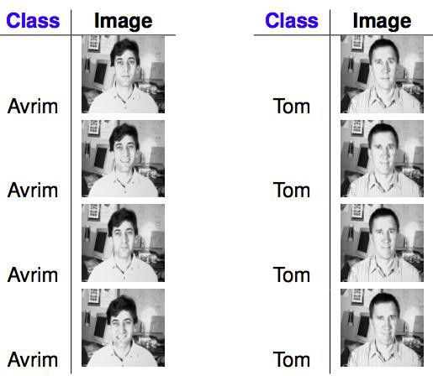
Classification Example: Face Recognition
What is a good representation for images?
Courtesy from Hamed Pirsiavash
Pixel values? Edges?
47

Slide 46
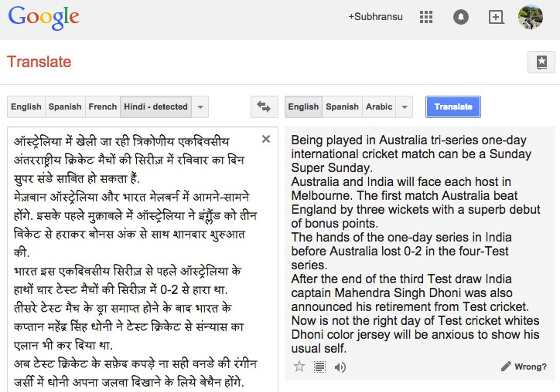
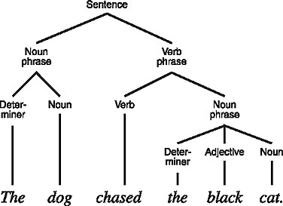
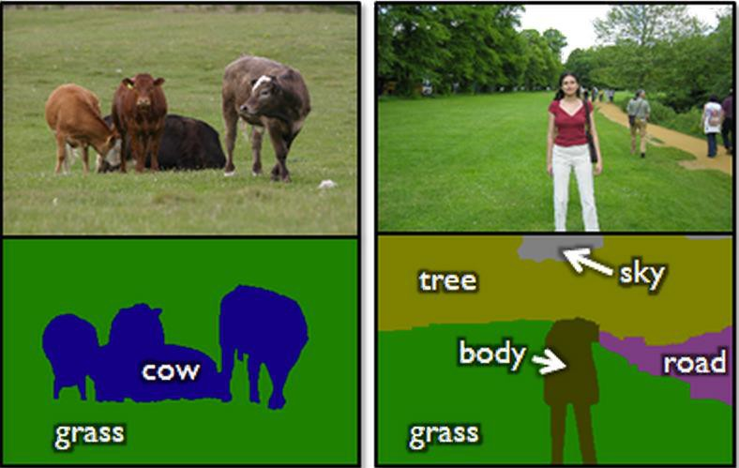
Classification Example: Sequence & Structured Prediction
Courtesy Hamed Pirsiavash

Slide 47
Ingredients for classification
Inject your knowledge into a learning system
Training data: labeled examples
Feature representation
Model
Courtesy Hamed Pirsiavash

Slide 48
Ingredients for classification
Inject your knowledge into a learning system
Problem specific
Difficult to learn from bad ones
Training data: labeled examples
Feature representation
Model
Courtesy Hamed Pirsiavash

Slide 49
Ingredients for classification
Inject your knowledge into a learning system
Problem specific
Difficult to learn from bad ones
Labeling data == $$$
Sometimes data is
available for “free”
Training data: labeled examples
Feature representation
Model
Courtesy Hamed Pirsiavash

Slide 50
Ingredients for classification
Inject your knowledge into a learning system
No single learning algorithm is always good (“no free lunch”)
Different learning algorithms work differently
Problem specific
Difficult to learn from bad ones
Labeling data == $$$
Sometimes data is
available for “free”
Training data: labeled examples
Feature representation
Model
Courtesy Hamed Pirsiavash

Slide 51
Regression
Like classification, but real-valued
54

Slide 52
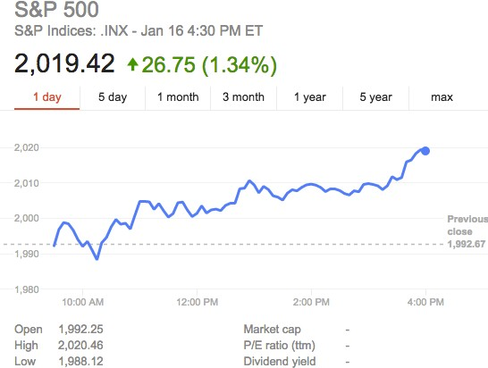
Regression Example: Stock Market Prediction
Courtesy Hamed Pirsiavash

Slide 53
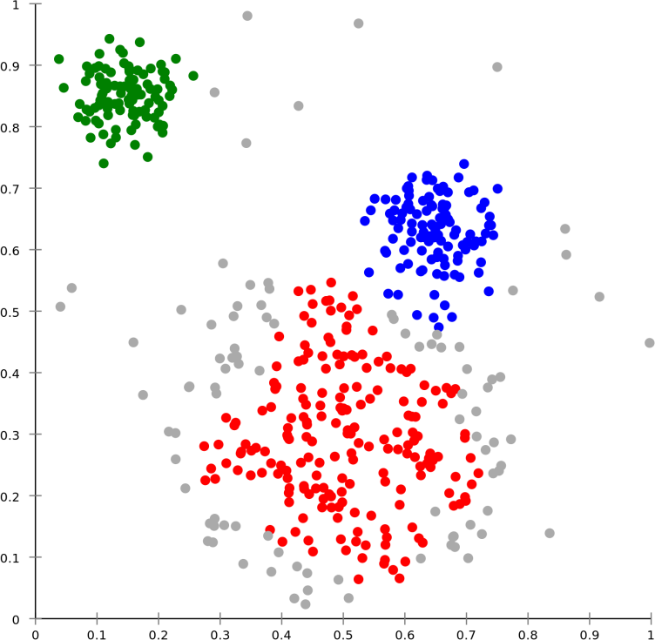
Unsupervised learning: Clustering
Courtesy Hamed Pirsiavash

Slide 54
Unsupervised learning: Clustering
Courtesy Hamed Pirsiavash

